Slide 1
MAGNETIC RECONNECTIONS
Here is where your presentation begins

Slide 2
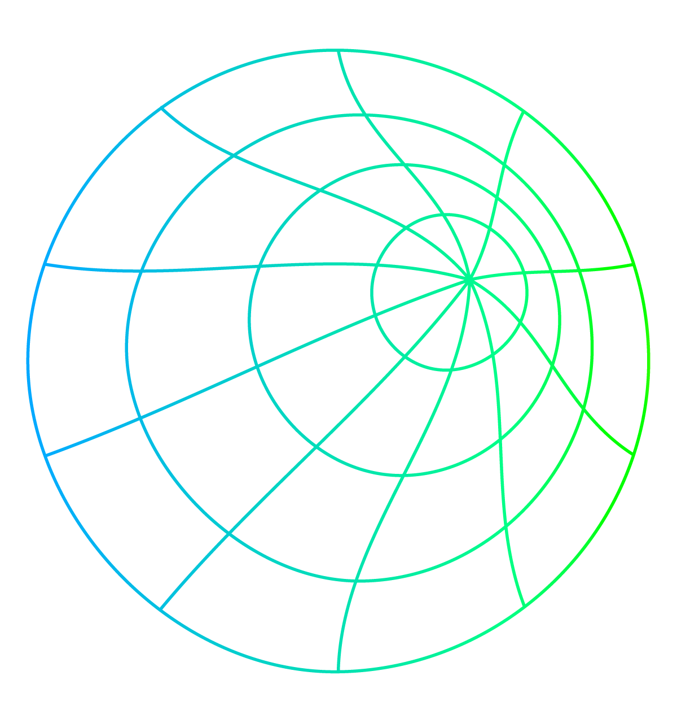
TABLE OF CONTENTS
01
02
03
04
About the problem
Our Approach
Objectives
Solution

Slide 3
INTRODUCTION
Magnetic reconnection is a fundamental process in plasma physics and astrophysics that occurs when the magnetic field lines in a plasma (a hot, ionized gas composed of charged particles) break and then reconnect in a different configuration. During magnetic reconnection, magnetic energy is converted into kinetic energy and thermal energy, leading to various dynamic and energetic phenomena.

Slide 4
01
About the project
Phenomenon of Magnetic reconnection

Slide 5

Magnetic Reconnection Illustration
Magnetic reconnection: Magnetic field lines break, twist, and reconnect, releasing energy, causing phenomena like solar flares and geomagnetic storms.
Magnetic lines break, forming an X-point, releasing stored energy, accelerating charged particles, and causing dynamic plasma phenomena in astrophysical and laboratory settings.

Slide 6
Effects due to MR
Geomagnetic Storms
Radio blackout
Satellite damage
Signal disruption
Navigation error
Power grid damage
Communication frequency fluctuation
Auroras
Magnetotail Dynamics
Particle acceleration
Ionospheric changes

Slide 7
DATA PROJECT ARCHITECTURE
PROBLEM
DATA
EDA
Decision
MODELLING
PREDICTION
CONCLUSION

Slide 8
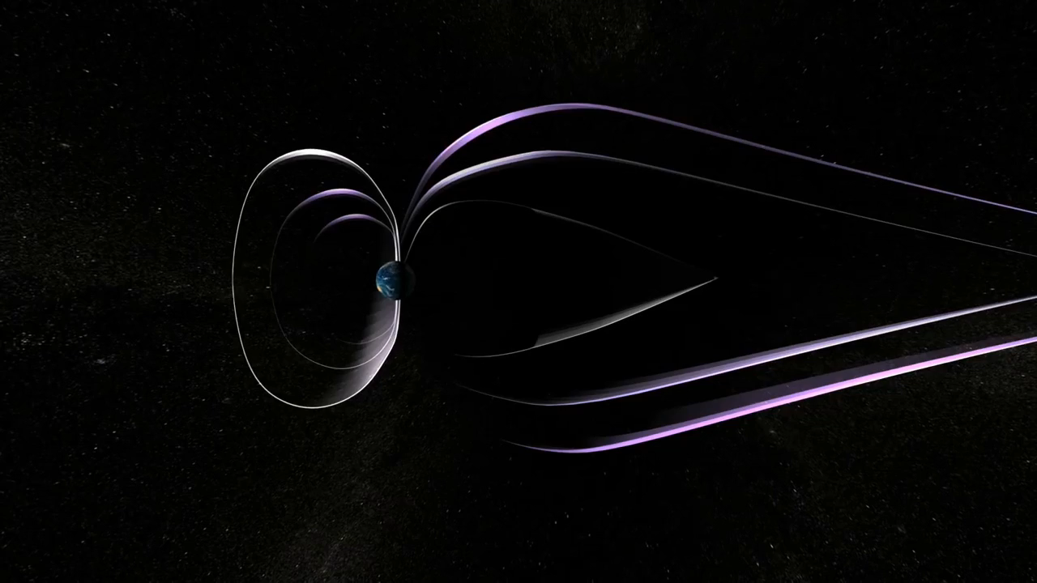
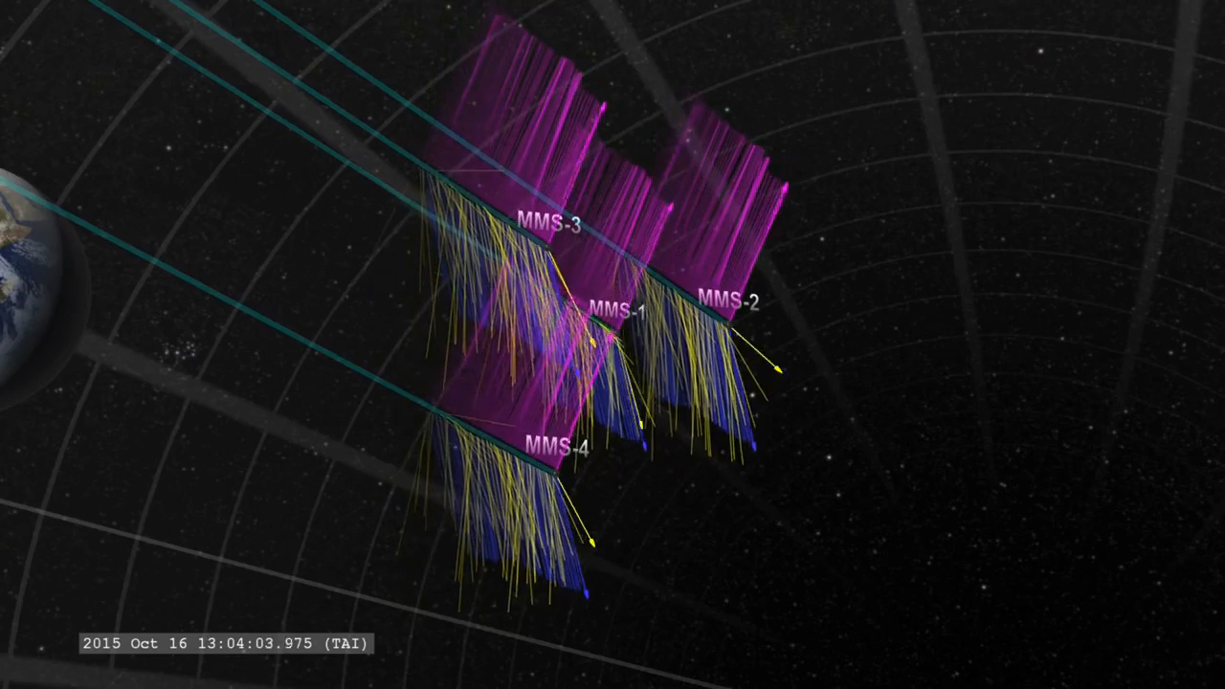
MR Event

Slide 9
Recent events In 2006, a geomagnetic storm disabled several satellites in the Global Positioning System (GPS) constellation. in 2013, a geomagnetic storm caused a communications outage on the International Space Station. In 2020, a geomagnetic storm caused a power outage on a SpaceX Starlink satellite.

Slide 10
Approach towards problem
Data Exploration
Data selection
Features selection
Features extraction
Graph plotting
Analysis of event
Pattern observation
Model implementation
Hybrid Model
Accuracy calibration
Prediction

Slide 11
Data Exploration Data Collection and Understanding 1.Gather data from ACE, WIND, and DSCOVR missions regarding the IMF vector components (X, Y, Z). 2. we observed and understand the physical meanings and the typical ranges of the measurements.

Slide 12
Features selection and Extraction 1.Clean the Data: Ensure there are no missing or erroneous values 2. Normalization : Given the likely variance in magnitude among the components, normalization might be necessary. 3. Segmentation : Divide the data into time segments for which you want to predict MR events. 4.Define Features : Apart from X, Y, Z components, compute additional features like magnitude of the vector, time derivative of components, etc.

Slide 13
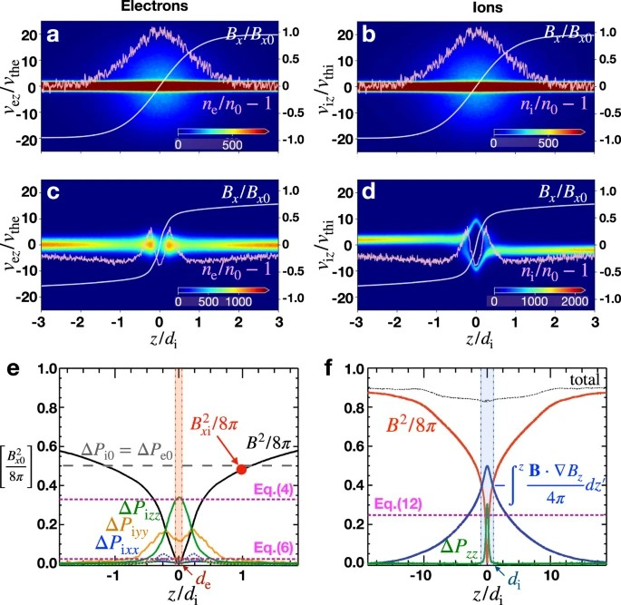
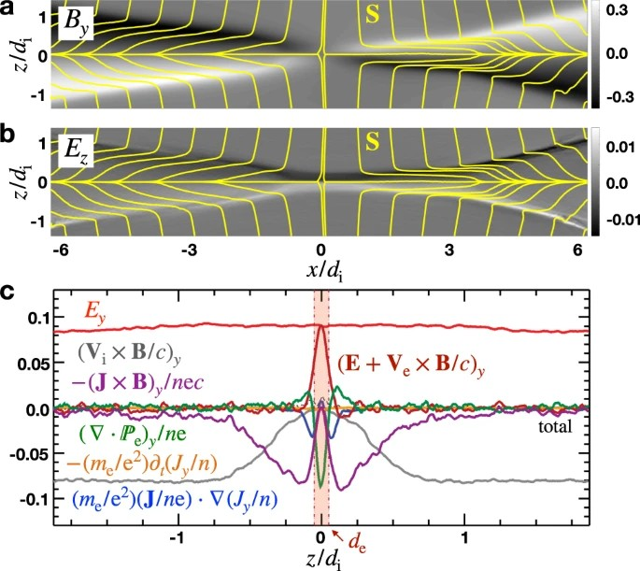
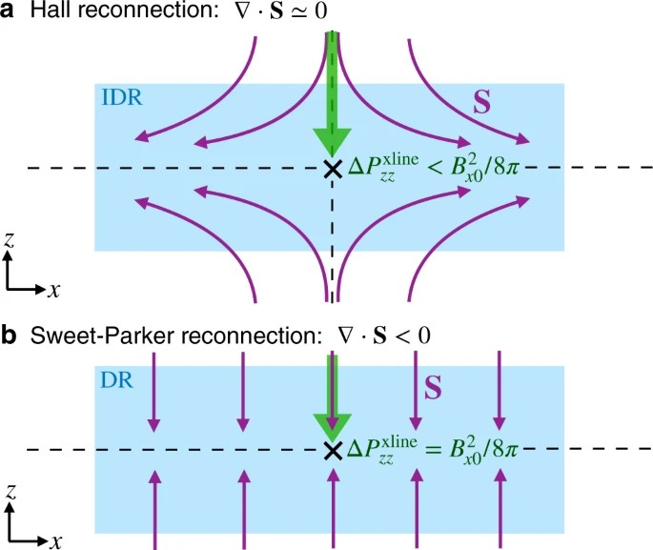
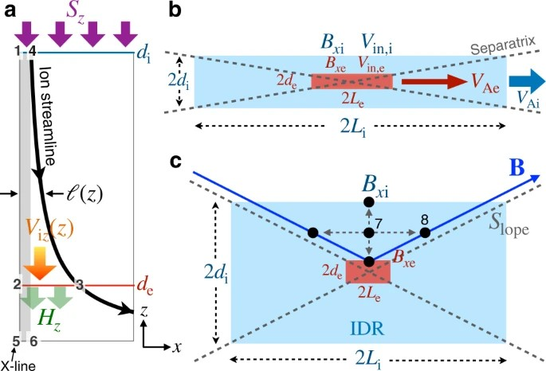
Parameters Observation

Slide 14
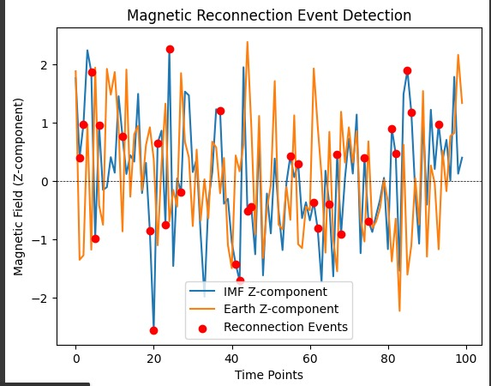
Feature detection

Slide 15
Model selection 1. Model Selection : Choose a model appropriate for time-series data (e.g., LSTM, GRU, or a temporal convolutional network).. 2. Problem Framing: Define clearly whether it is a classification (does MR occur or not) or regression (predicting the intensity or impact of MR) problem.

Slide 16
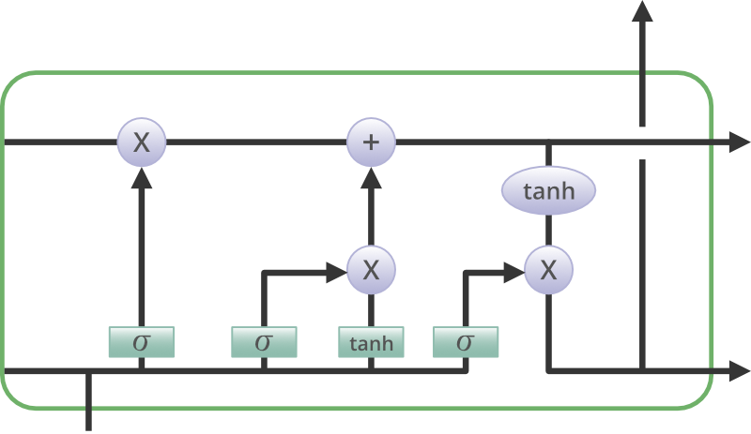
Model implementation RNN - Recurrent Neural Network SVM - Support Vector Machine LSTM - Long Short-Term Memory

Slide 17
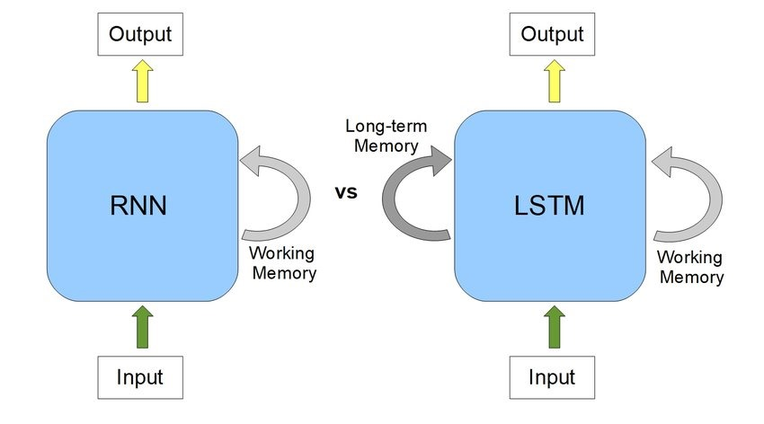
Model implementation RNN - Recurrent Neural Network

Slide 18
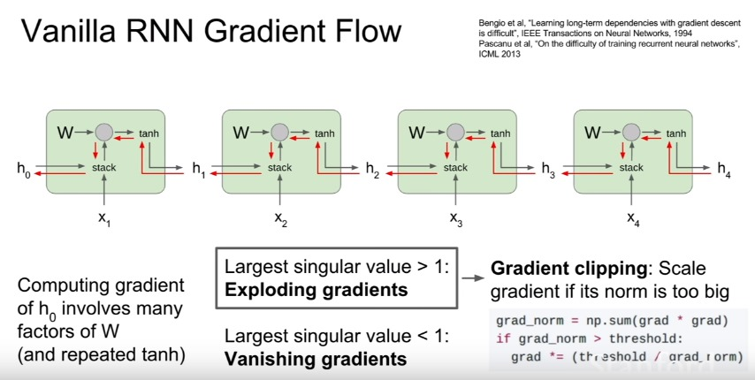
Model implementation RNN - Recurrent Neural Network

Slide 19
LSTM- Long Short-Term Memory Accuracy: LSTM networks have been shown to be very accurate in forecasting future values of time series data. This is because they are able to learn complex patterns in the data, even when the data is noisy or incomplete. Flexibility: LSTM networks can be used to forecast a wide variety of time series data, including stock prices, weather patterns, and customer demand.* Scalability: LSTM networks can be scaled up to handle large datasets, making them suitable for enterprise applications.

Slide 20
References
https://www.nature.com/articles/s42005-022-00854-x
https://agupubs.onlinelibrary.wiley.com/doi/full/10.1029/2018JA025935
https://youtu.be/8NDPsSZCcz0?si=dkUpgRlmexI8RMuO
https://youtu.be/mgUZwoR0gcE?si=zkT4DBZP4vHJN_XZ
https://youtu.be/vTY0JGTaSsg?si=ZefFeSsqHzXPunIJ

Slide 21
Team Details
Team Name : cybernauts
Problem Statement : Magnetic Reconnection
Members : Jal Patel (Leader)
Smit Patel
Prit Chavda
Tejas Raval
Vraj Patel
Joshi Bharadwaj

Slide 22
Results
Achieved 84 % accuracy on Training data with 100 epochs using sunspots data
- 83% accuracy on validation data
- 79% accuracy on testing data

Slide 23
THANK YOU

